Slide 1

Database Connection Assignment
Authors
1.Azhar Shaheer Badal
2.Chit Wui Lam
3.Tony Machado
4.Jose Arturo Vega Lopez
5.Yung yu Wan
MSC Data Science and Artificial Intelligence
Module :-CSCK542 Databases and Information systems

Slide 2

Roles and Responsibilities
Database Designer /Engineer - Yung yu Wan
Project Manager - Azhar Shaheer Badal
Software Engineer- Jose Arturo Vega Lopez
Tester - Chit Wui Lam
Video Creator - Tony Machado

Slide 3

Construction of Database
Yung yu Wan

Slide 4
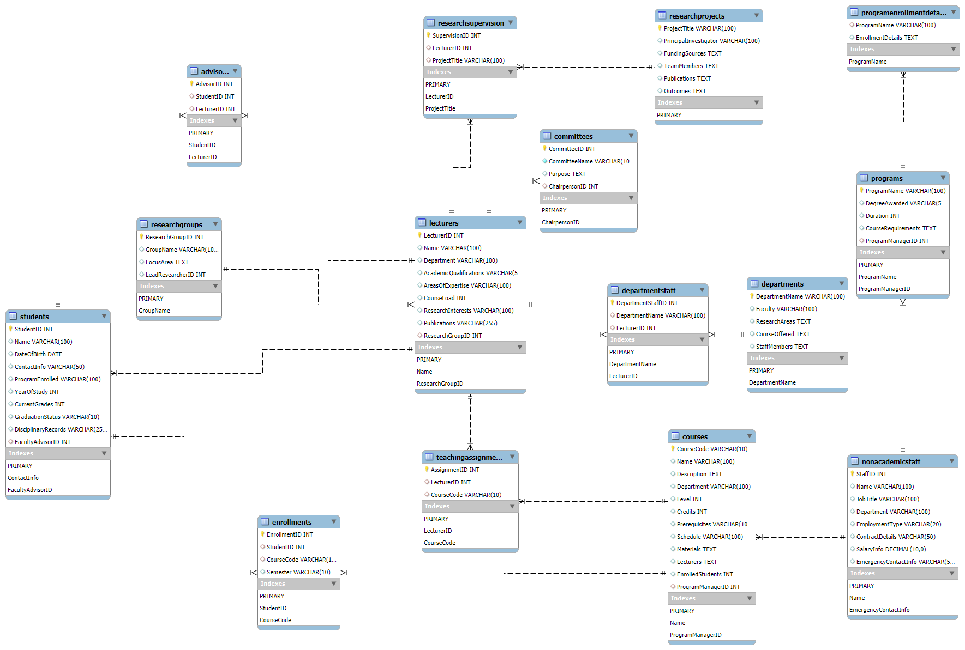
Entity Relationship Diagram
Notes:
we present the Entity Relationship Diagram (ERD) for our database. The ERD visually represents the structure of our database, showing the entities, their attributes, and the relationships between them. Key entities include Students, Lecturers, Courses, and Research Projects. Each entity has a primary key to uniquely identify records, and foreign keys to establish relationships with other entities. For example, the LecturerID in the Students table links each student to their faculty advisor. This diagram helps us understand the database structure and ensures data integrity by defining clear relationships between entities.

Slide 5
Construction of Database-Create Table
Table Name | Primary Key | Test Require | Foreign Key | Test Require | Non-Nullable | Test Require
ResearchGroups | ResearchGroupID - Auto Increment | FALSE | N/A | FALSE | N/A | N/A
Lecturers | LecturerID - Auto Increment | FALSE | ResearchGroupID | TRUE | N/A | N/A
Students | StudentID - Auto Increment | FALSE | LecturerID | TRUE | N/A | N/A
NonAcademic Staff | Staff - Auto Increment | FALSE | N/A | FALSE | N/A | N/A
Courses | CourseCode | TRUE | N/A | FALSE | N/A | N/A
Departments | DepartmentName | TRUE | N/A | FALSE | N/A | N/A
Programs | ProgramName | TRUE | N/A | FALSE | N/A | N/A
ResearchProjects | ProjectTitle | TRUE | N/A | FALSE | N/A | N/A
Enrollments | Enrolment ID - Auto Increment | FALSE | StudentID, CourseCode | TRUE | N/A | N/A
Advisors | Advisor ID - Auto Increment | FALSE | StudentID, LecturerID | TRUE | N/A | N/A
TeachingAssignments | Assignment ID - Auto Increment | FALSE | LecturerID, CourseCode | TRUE | N/A | N/A
ResearchSupervision | SupervisionID - Auto Increment | FALSE | LecturerID, ProjectTitle | TRUE | N/A | N/A
DepartmentStaff | DepartmentStaffID - Auto Increment | FALSE | DepartmentName, LecturerID | TRUE | N/A | N/A
Committees | CommitteeID - Auto Increment | FALSE | LecturerID | TRUE | N/A | N/A
StudentOrganisations | OrganisationID - Auto Increment | FALSE | N/A | FALSE | N/A | N/A
StudentOrganisationMemberships | MembershipID - Auto Increment | FALSE | StudentID, OrganisationID | TRUE | N/A | N/A
Notes:
This is the construction of our database. The database design includes several tables, each with a primary key to uniquely identify records. For example, the StudentID in the students table and the LecturerID in the lecturer's table. We also use foreign keys to establish relationships between tables and enforce referential integrity. For instance, the Faculty AdvisorID in the students table ensures each student is linked to a valid faculty advisor.

Slide 6
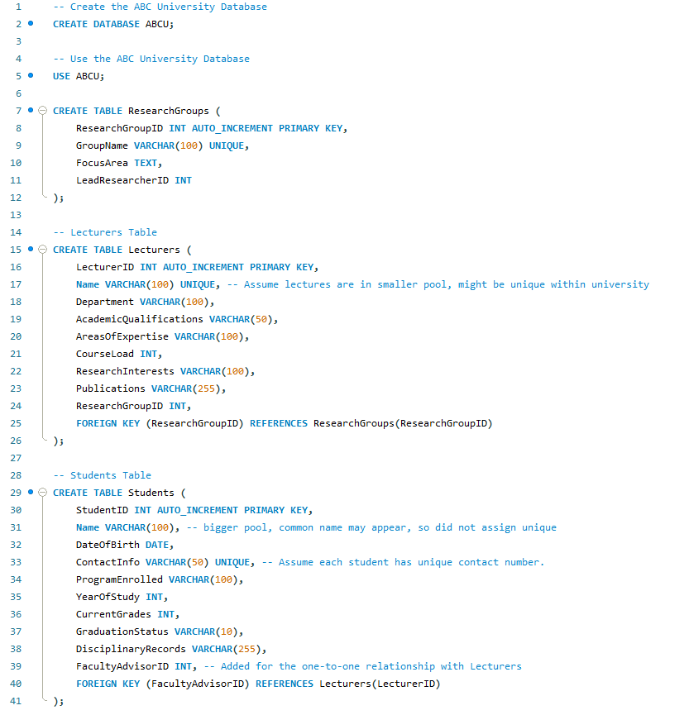
Construction of Database- Create Table
Each table should have a primary key to uniquely identify each record.
e.g., student ID in the student table
e.g., lecturer ID in the lecturer's table
Foreign keys establish relationships between tables and enforce referential integrity
e.g., Faculty Advisor ID in the student's table
e.g., "research Group ID"" in the lecturers table,
ensure each student is linked to a valid faculty advisor and each lecturer to a valid research group...
Choose appropriate data types for each column ensures efficient storage and retrieval
e.g., using VARCHAR for text field
e.g., INT for numeric fields
Notes:
SQL scripts are used to establish relationships between various entities in the university database. The Enrolments table handles the many-to-many relationship between students and courses, while the Advisors table manages the one-to-one relationship between students and their faculty advisors. Additionally, the Teaching Assignments table addresses the many-to-many relationship between lecturers and the courses they teach. Other tables like Research Supervision, Department Staff, and Committees handle one-to-many relationships.

Slide 7
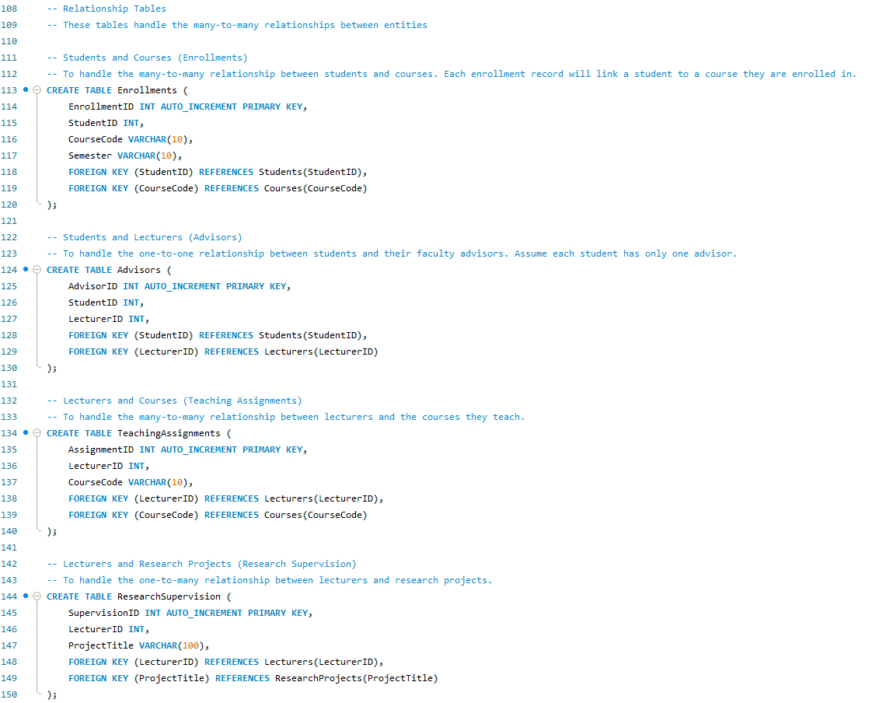
SQL script -Create Relationships
Establishes relationships between various entities in the university database. ensuring that lecturers are properly linked to research projects, departments, and committees. These relationships maintain data integrity and facilitate efficient data retrieval
→The Enrollments table handles the many-to-many relationship between students and courses, linking each student to the courses they are enrolled in.
→The Advisors table manages the one-to-one relationship between students and their faculty advisors.
→The Teaching Assignments table addresses the many-to-many relationship between lecturers and the courses they teach.
-→ Other tables like Research Supervision, Department Staff, and Committees handle one-to-many relationships,
Notes:
Here, we present the SQL scripts used to establish relationships between various entities in the university database. The Enrolments table handles the many-to-many relationship between students and courses, while the Advisors table manages the one-to-one relationship between students and their faculty advisors. Additionally, the Teaching Assignments table addresses the many-to-many relationship between lecturers and the courses they teach. Other tables like Research Supervision, Department Staff, and Committees handle one-to-many relationshipsEstablishes relationships between various entities in the university database. ensuring that lecturers are properly linked to research projects, departments, and committees. These relationships maintain data integrity and facilitate efficient data retrieval
→The Enrollments table handles the many-to-many relationship between students and courses, linking each student to the courses they are enrolled in.
→The Advisors table manages the one-to-one relationship between students and their faculty advisors.
→The Teaching Assignments table addresses the many-to-many relationship between lecturers and the courses they teach.
-→ Other tables like Research Supervision, Department Staff, and Committees handle one-to-many relationships,

Slide 8
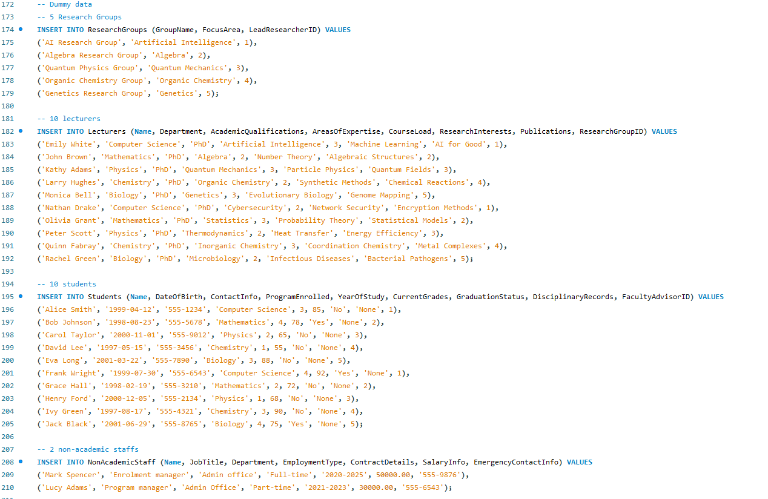
SQL scripts-Insert data
Notes:
we will discuss the insertion of dummy data into our database. This dummy data helps us test the functionality and relationships within our database. First, we have inserted data for five research groups, each with a unique focus area and a lead researcher. For example, the 'AI Research Group' focuses on Artificial Intelligence and is led by researcher ID 1. Next, we have added ten lecturers, each associated with a specific department, academic qualifications, areas of expertise, course load, research interests, publications, and a research group ID. For instance, Emily White from the Computer Science department specializes in Artificial Intelligence and is part of the AI Research Group. We have also included data for ten students, detailing their names, dates of birth, contact information, programs enrolled, years of study, current grades, graduation status, disciplinary records, and faculty advisor IDs. For example, Alice Smith is a third-year Computer Science student with a current grade of 85 and no disciplinary records, advised by faculty advisor ID 1. The input of Other data are similar....

Slide 9
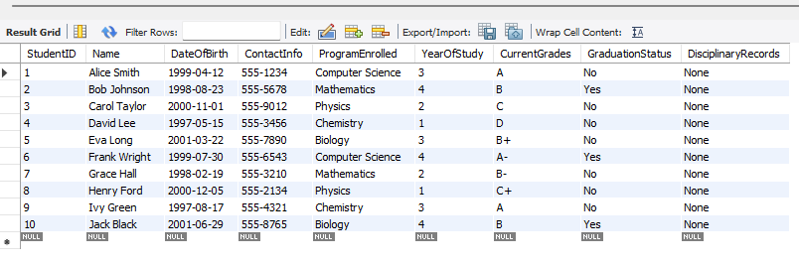
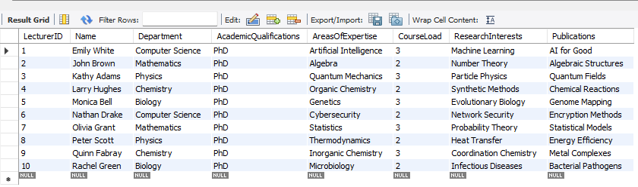
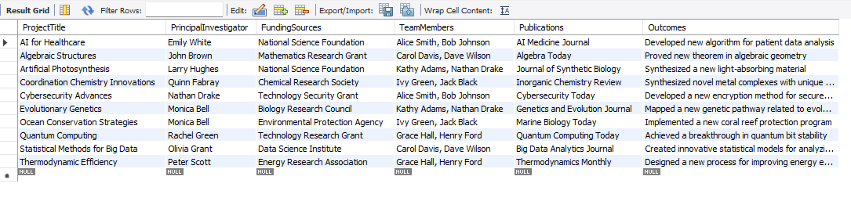
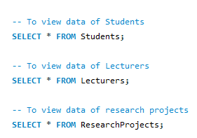
Tables generated in SQL
students
Lecturers
Research project
SQL script
Notes:
how to view the data in our SQL tables for research projects, lecturers, and students, we have created several SQL queries to retrieve data from these tables, allowing us to verify that the data has been correctly inserted and to perform various operations on the data. e.g. , to view the data of research projects, we use the query SELECT * FROM Research Projects;. This query retrieves all the records from the Research Projects table, displaying information such as project titles, principal investigators, funding sources, team members, publications, and outcomes. Similarly, we can view the data of lecturers using the query SELECT * FROM Lecturers;. This query retrieves all the records from the Lecturers table, showing details like lecturer names, departments, academic qualifications, areas of expertise, course loads, research interests, publications, and research group IDs.
We also have a query to view the data of students using SELECT * FROM Students;. This query retrieves all the records from the Students table, displaying information such as student names, dates of birth, contact information, programs enrolled, years of study, current grades, graduation status, disciplinary records, and faculty advisor IDs.

Slide 10
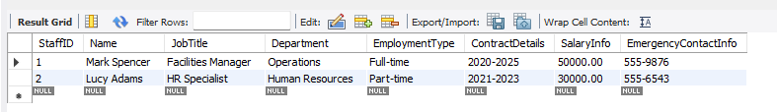
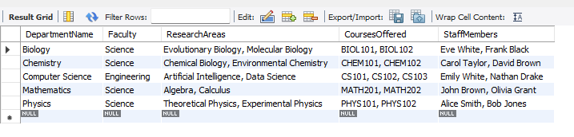
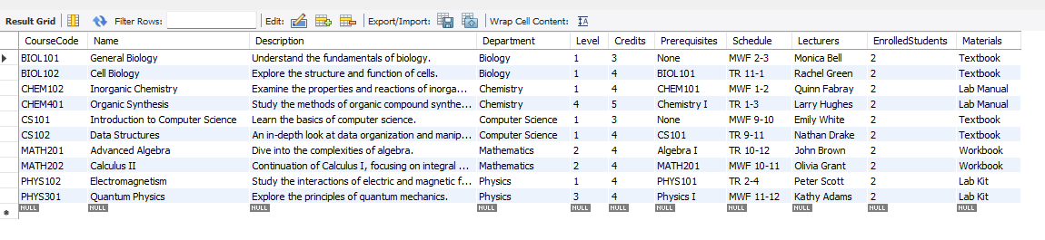
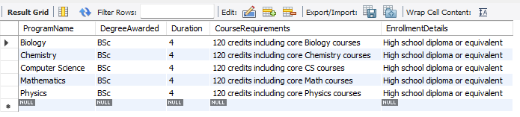
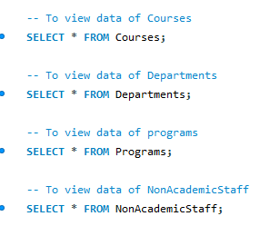
Tables generated in SQL
NA staffs
Departments
Course Deatils
programs
SQL script
Notes:
This slides presented the SQL tables for non-academic staff, programs, course details, and departments. We also use the queries SELECT * FROM Non AcademicStaff;, SELECT * FROM Programs;, SELECT * FROM Courses;, and SELECT * FROM Departments; to retrieve all records from these tables. This helps us ensure data integrity and perform various operations on the data.

Slide 11
Query Interface –Python
By
Jose Arturo Vega Lopez

Slide 12
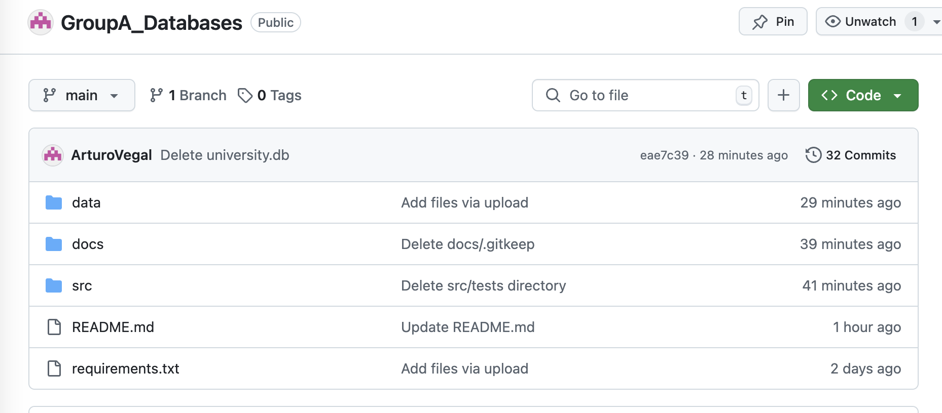
Query Interface –Python
https://github.com/ArturoVegal/GroupA_Databases/tree/main
https://github.com/ArturoVegal/GroupA_Databases/blob/master/README.md
https://github.com/ArturoVegal/GroupA_Databases/blob/main/requirements.txt

Slide 13
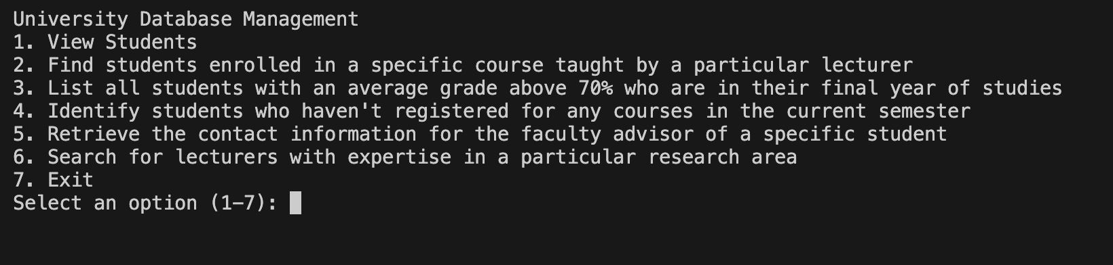
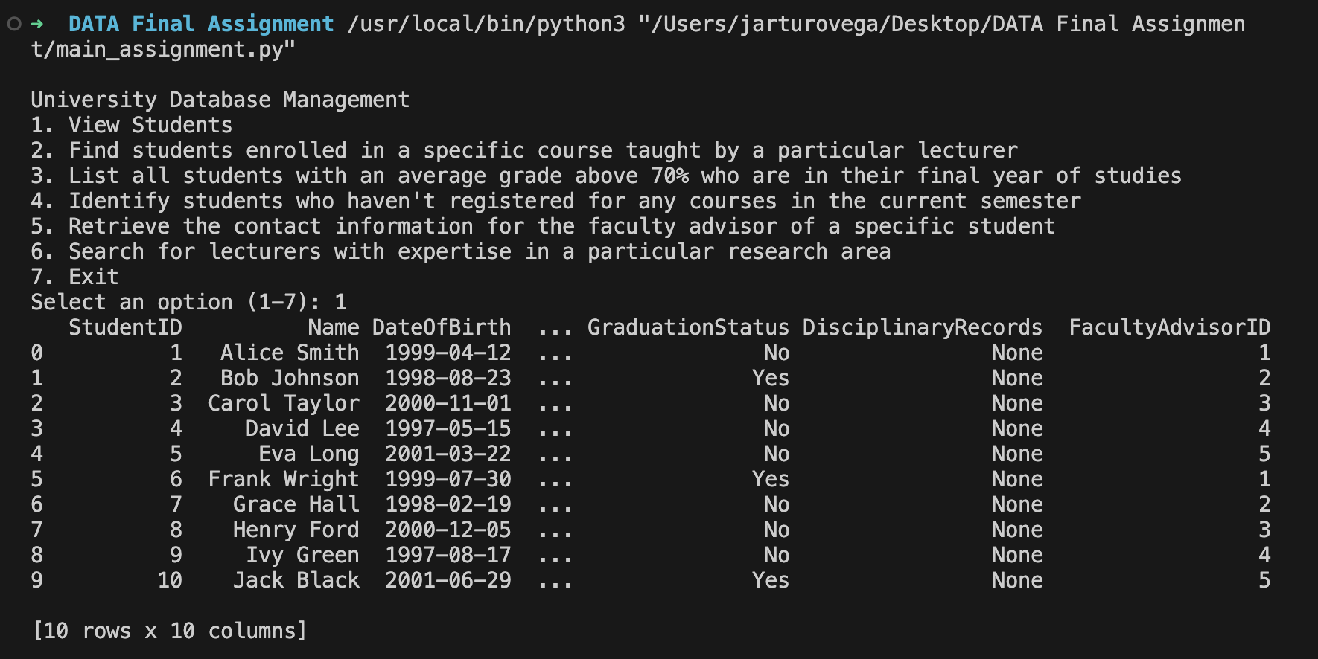
Query Interface –Python
Query #1

Slide 14
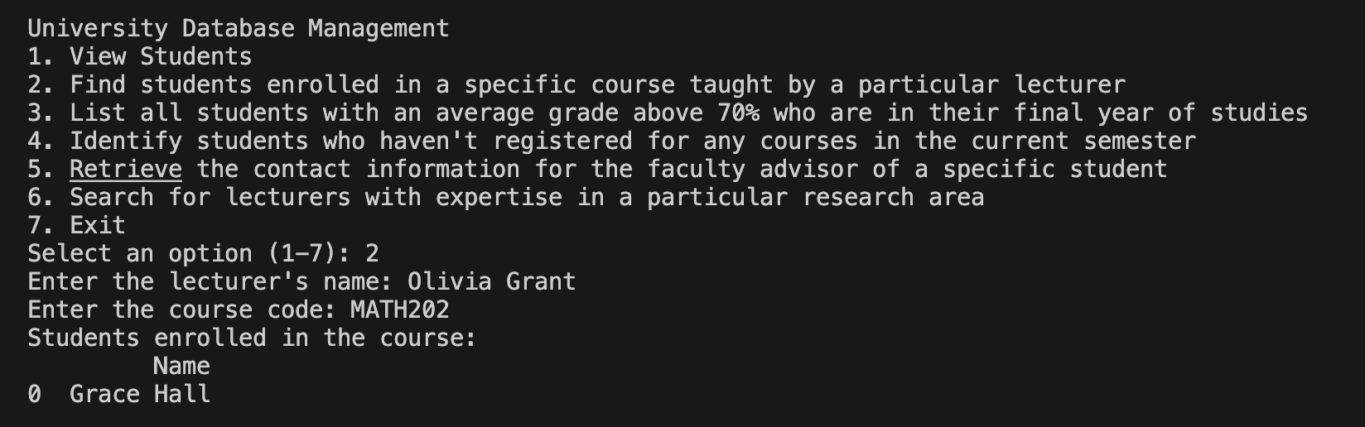
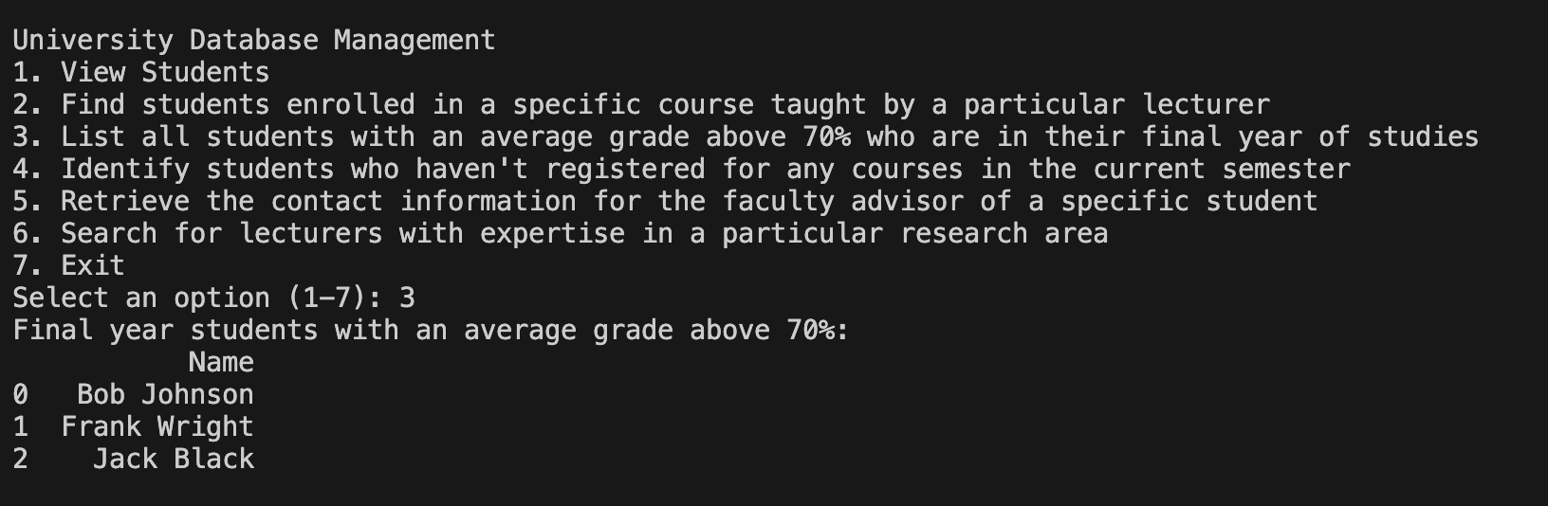
Query Interface –Python
Query#2
Query#3

Slide 15
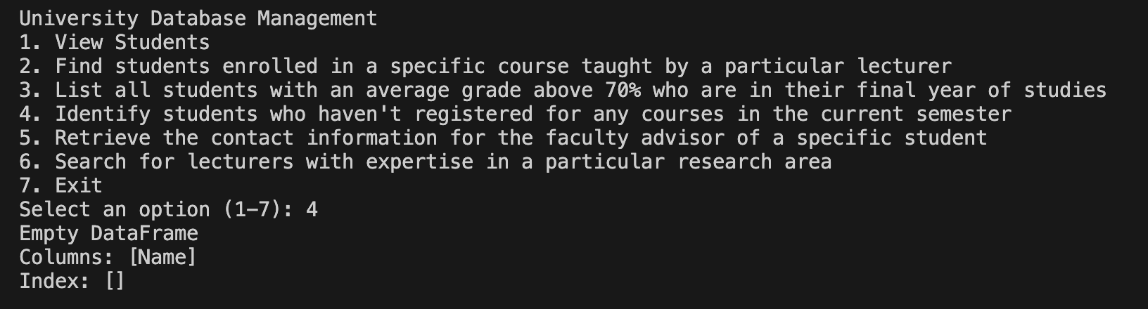
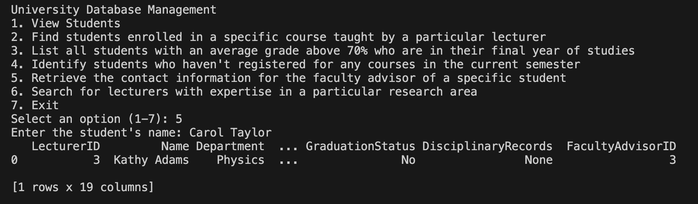
Query Interface –Python
Query#4
Query#5

Slide 16
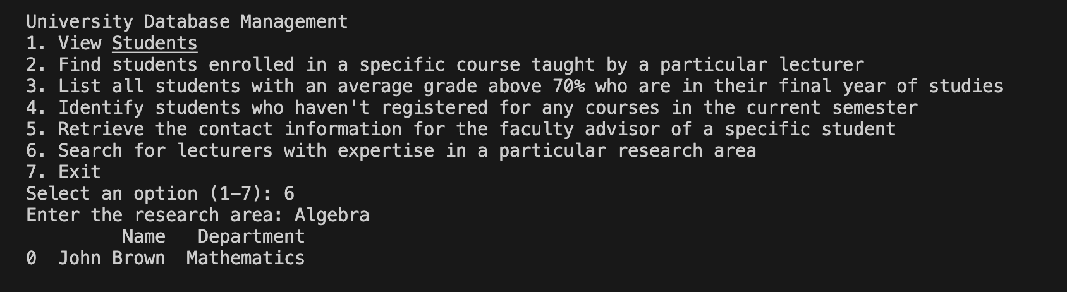
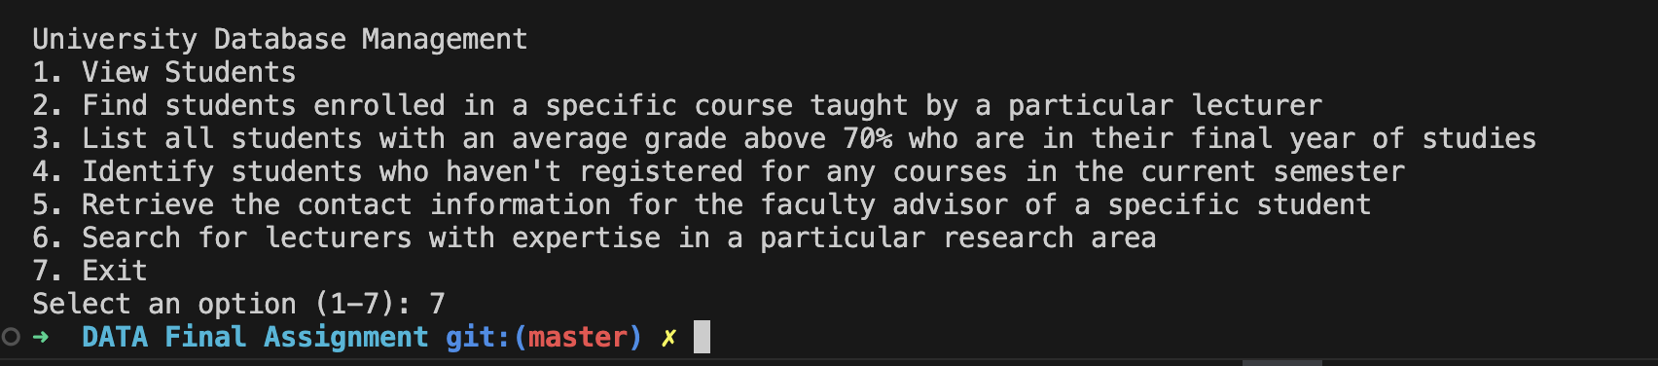
Query Interface –Python
Query#6
Option 7-Exit

Slide 17
Recording
Screen Recording 2024-10-04 at 20.59.47.mov

Slide 18
Testing
By
Chit Wui Lam

Slide 19
Test Plan
Define test cases
Data integrity tests
Validate the primary keys are unique
Ensure foreign key constraints are enforced
Check for null values in non-nullable fields
CRUD Operations
Create: Test inserting new records into each table.
Read: Execute SELECT queries to retrieve data and verify accuracy.
Update: Modify existing records and ensure changes are reflected.
Delete: Remove records and check that they are properly deleted.
Relationship Tests:
Verify many-to-many relationships.
Ensure one-to-one relationships.
Security Testing
Access Control: Ensure that only authorized users can access or modify data.
Backup and Recovery Testing
Verify that backup procedures work correctly.
Test data restoration from backups to ensure data integrity.

Slide 20
Data integrity tests Testing environment: MySQL Workbench
Foreign key test to Confirm that foreign key constraints are working correctly based on the table structure and dummy data.
Validate the primary keys are unique; test cases will only include the table with Primary Key is not auto increment
Table Name | Primary Key | Test Require
Research Groups | Research Group ID - Auto Increment | FALSE
Lecturers | Lecturer ID - Auto Increment | FALSE
Students | Student ID - Auto Increment | FALSE
Non-Academic Staff | Staff - Auto Increment | FALSE
Courses | Course Code | TRUE
Departments | Department Name | TRUE
Programs | Program Name | TRUE
ProgramEnrollmentDetails | N/A | FALSE
ResearchProjects | ProjectTitle | TRUE
Enrollments | Enrollment ID - Auto Increment | FALSE
Advisors | Advisor ID - Auto Increment | FALSE
TeachingAssignments | AssignmentID - Auto Increment | FALSE
ResearchSupervision | Supervision ID - Auto Increment | FALSE
DepartmentStaff | DepartmentStaffID - Auto Increment | FALSE
Committees | CommitteeID - Auto Increment | FALSE
Table Name | Foreign Key | Test Require
Research Groups | N/A | FALSE
Lecturers | Research Group ID | TRUE
Students | LecturerID | TRUE
NonAcademicStaff | N/A | FALSE
Courses | Program Manager ID | TRUE
Departments | N/A | FALSE
Programs | StaffID | TRUE
ProgramEnrollmentDetails | ProgramName | TRUE
ResearchProjects | N/A | FALSE
Enrollments | StudentID, CourseCode | TRUE
Advisors | StudentID, LecturerID | TRUE
TeachingAssignments | LecturerID, CourseCode | TRUE
ResearchSupervision | LecturerID, ProjectTitle | TRUE
DepartmentStaff | DepartmentName, LecturerID | TRUE
Committees | LecturerID | TRUE

Slide 21
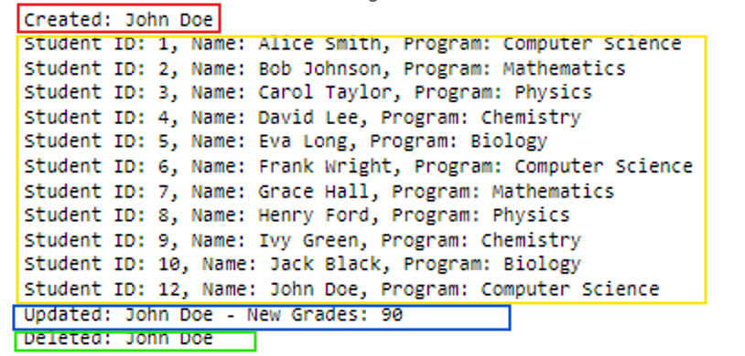
CRUD Operations Test
Implement SQL alchemy python library to perform CRUD test for database.
Create data
Read data
Change data
Delete data
Test results

Slide 22
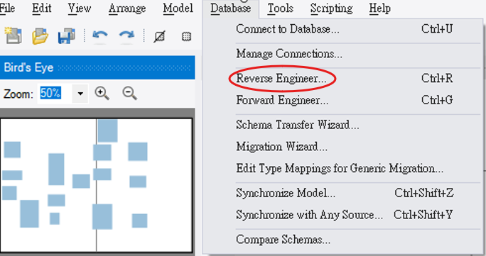
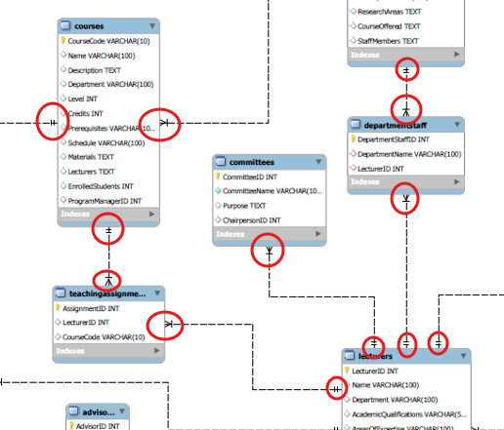
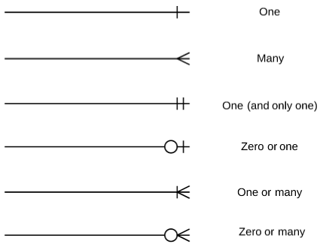
Relationship Test:
Verify table relationship by using MySQL workbench “Reverse Engineer” function to generate an EER diagram from database.

Slide 23
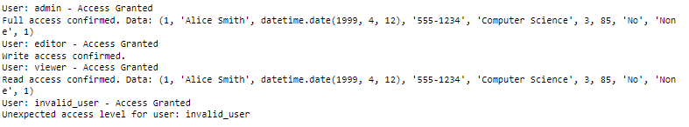


Data integrity tests Testing environment: MySQL Workbench
Security Testing
Access Control test
Backup and Recovery Testing

Slide 24
Thank You

